Slide 1
Data 621 Project 4
Joby John & Jun Pan
Revised April 27, 2019

Slide 2
Your objective is to build multiple linear regression and binary logistic regression models on the training data to predict the probability that a person will crash their car and also the amount of money it will cost if the person does crash their car.
Overview In this homework assignment, you will explore, analyze and model a data set containing approximately 8000 records representing a customer at an auto insurance company. Each record has two response variables. The first response variable, TARGET_FLAG, is a 1 or a 0. A "1" means that the person was in a car crash. A zero means that the person was not in a car crash. The second response variable is TARGET_AMT. This value is zero if the person did not crash their car. But if they did crash their car, this number will be a value greater than zero. Your objective is to build multiple linear regression and binary logistic regression models on the training data to predict the probability that a person will crash their car and also the amount of money it will cost if the person does crash their car. You can only use the variables given to you (or variables that you derive from the variables provided). Below is a short description of the variables of interest in the data set:

Slide 3
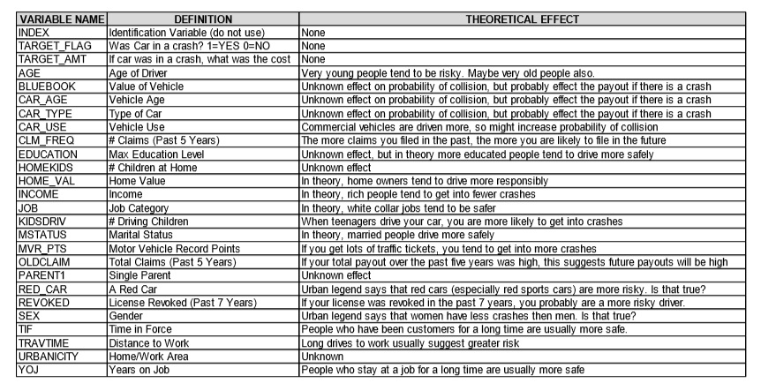
Data Set Information

Slide 4
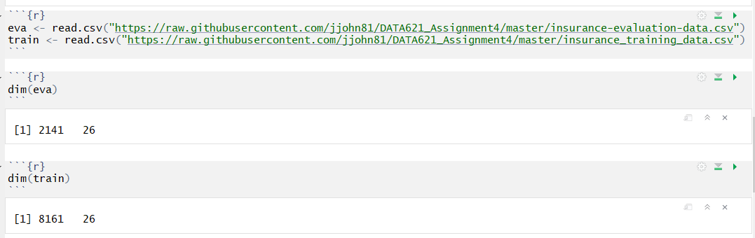
Data Exploration
Databases were loaded from github repository:
https://github.com/jjohn81/DATA621_Assignment4
In train dataset, there were 8161 observers and 26 variables.
In evaluation dataset, there were 2141 observers and 26 variables.

Slide 5
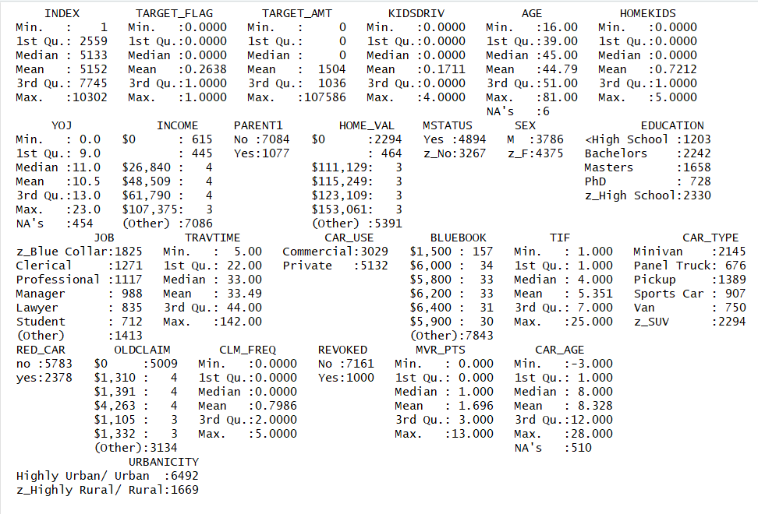
Summarize Train Data

Slide 6
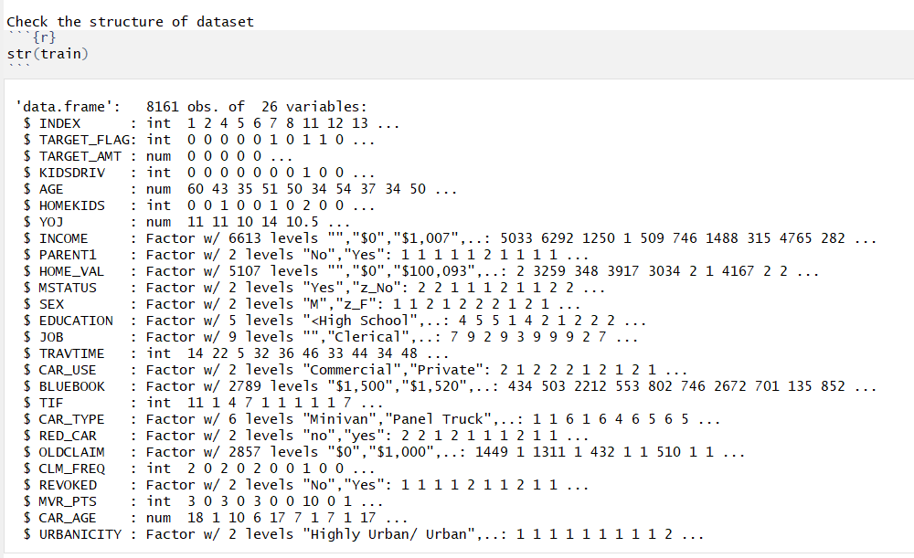
Structure of the Data Set

Slide 7
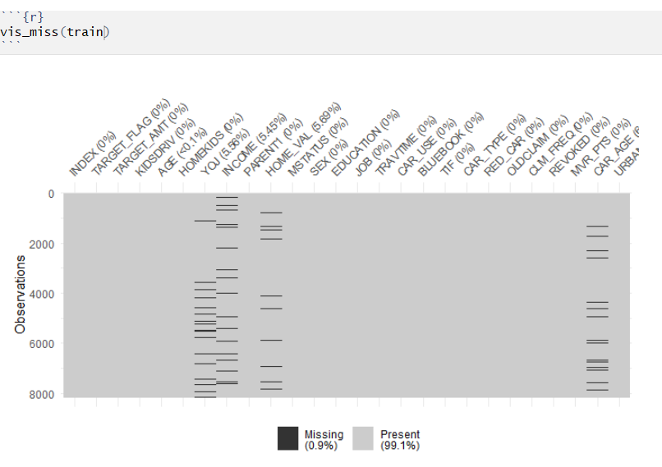
Check Missing Values

Slide 8

Detailed information about NA
Dataset contains 8161 rows and 25 variables. There are 6 observations missing data for Age, 454 missing data for YOK, 445 missing data for income , 464 missing data of home value and 510 missing data on car_age.

Slide 9
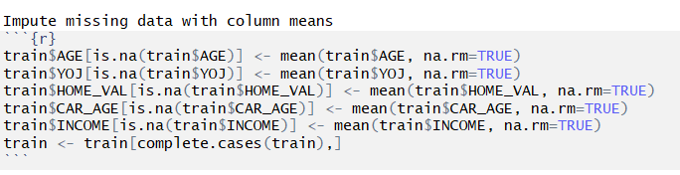
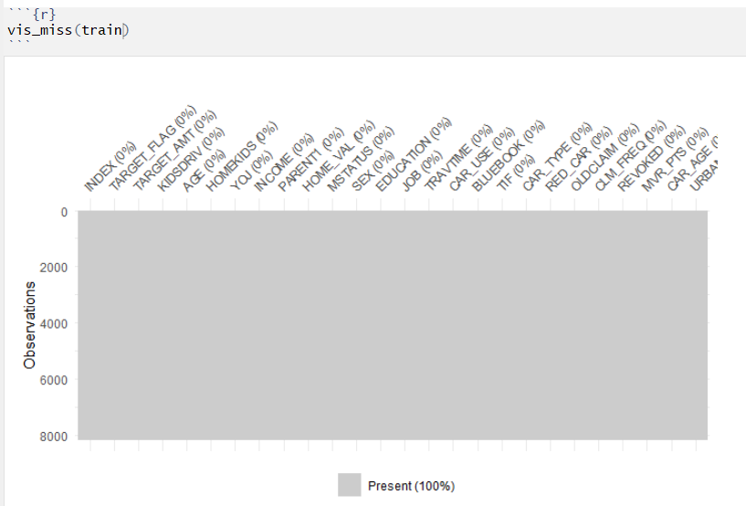
Impute missing values with mean
No Missing
Values

Slide 10
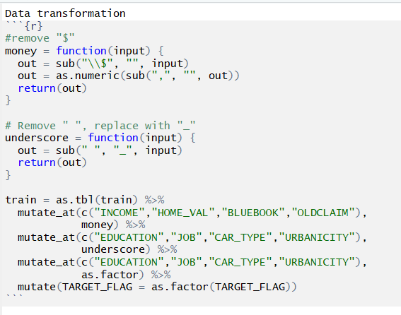
Transform Data
1: remove $ sign from INCOME, HOME_VAL, BLUEBOOK, OLDCLAIM;
2: replace " " with underscore "_" of variables : EDUCATION, JOB, CAR_TYPE, URBANICITY
3: change it as factors for above variabls plus TARGET_FLA

Slide 11
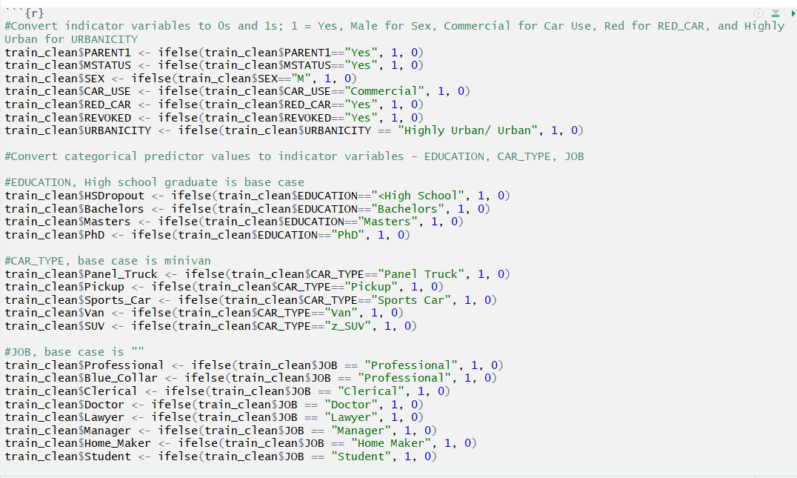
Convert Variables

Slide 12
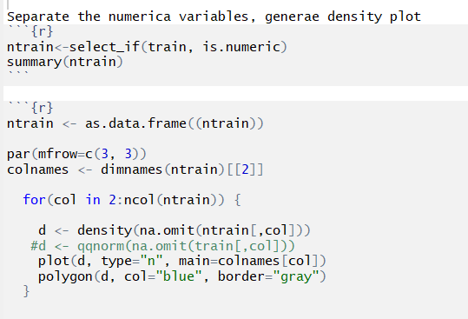
Density Plot of Numerical Variables

Slide 13
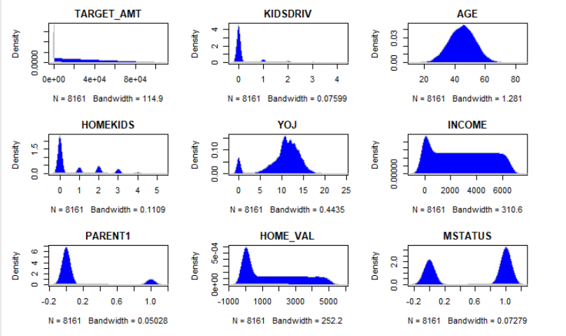

Slide 14
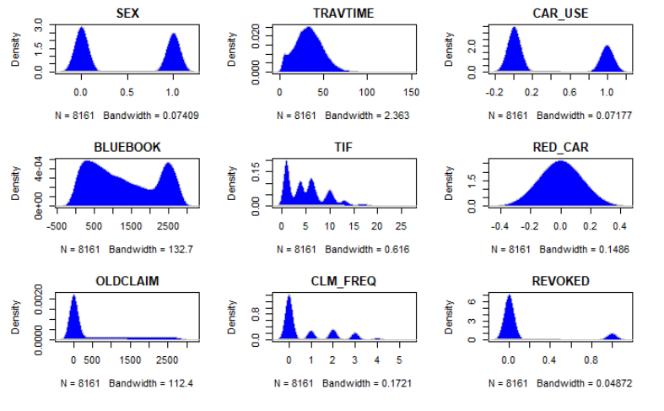

Slide 15
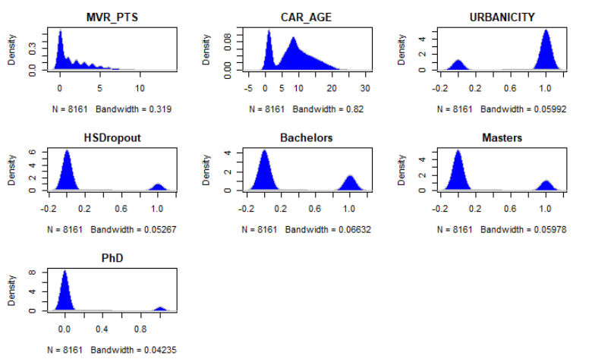

Slide 16
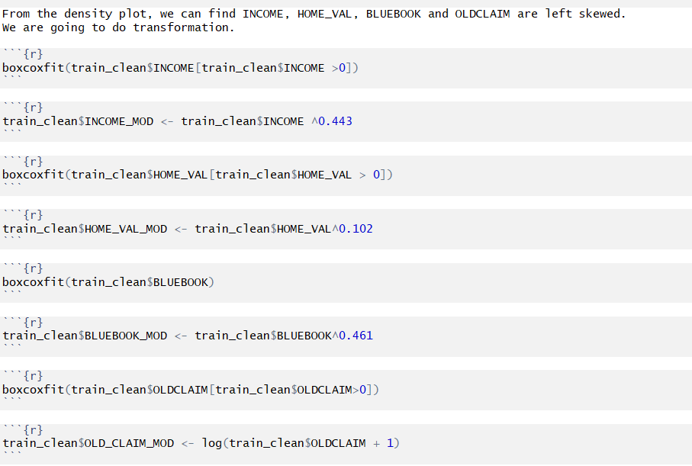
Modify Skewed Variables

Slide 17
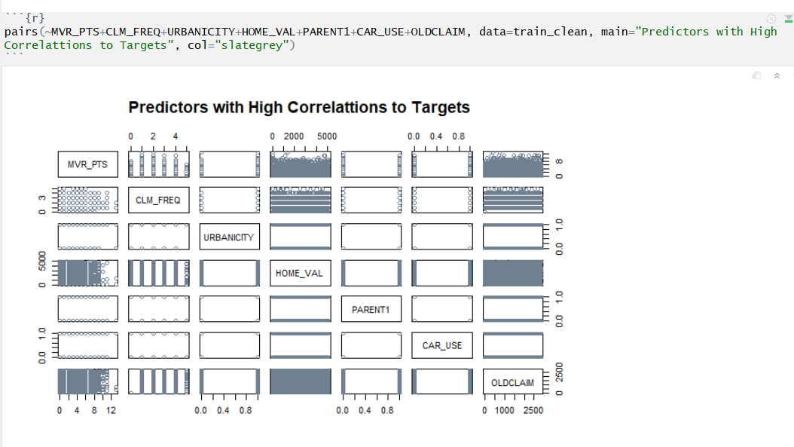

Slide 18
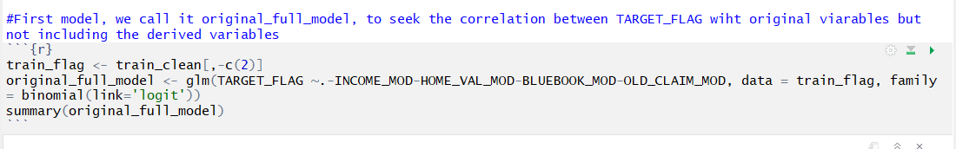
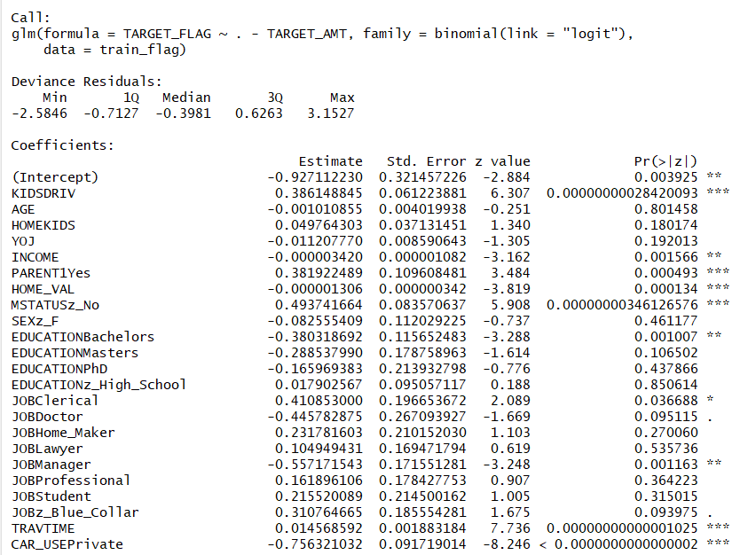
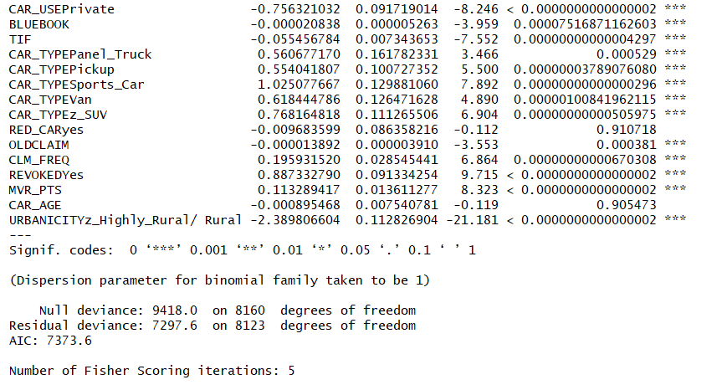
Original Full Model

Slide 19
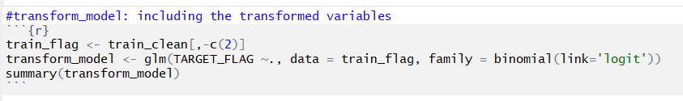
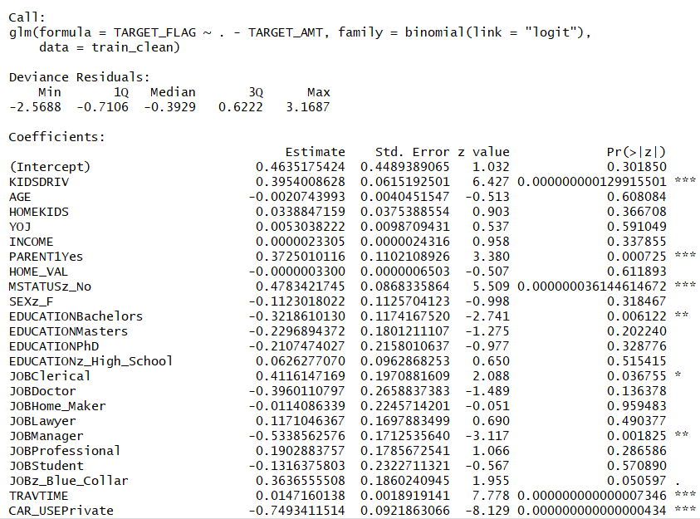
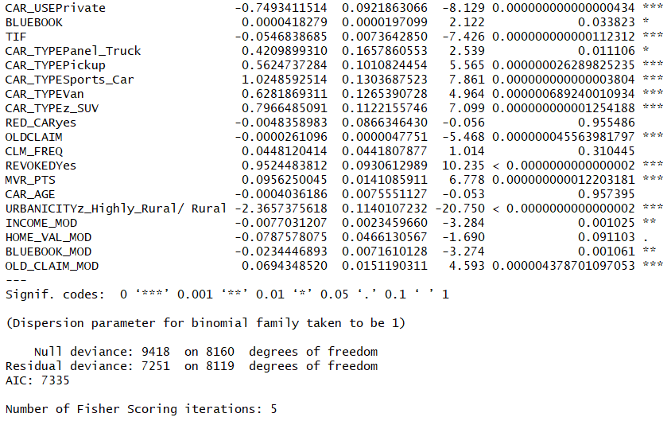
Transformed Model

Slide 20
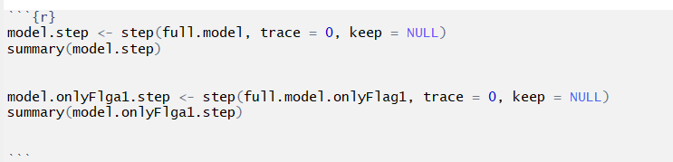
Stepwise Model
Third model, we call it Step model, seeks the correlation between TARGET_FLAG with original viarables. This model uses “Stepwise Algorithm” on “Transformed Model”. In this model, most of the variables are statistically significant with AIC score of 7322. This model inludes only 32 predictor variables, other models have 42 predictors variables. This is a simpler model than the previous models with better AIC.

Slide 21
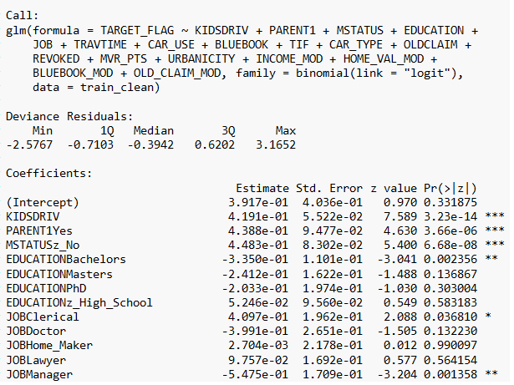
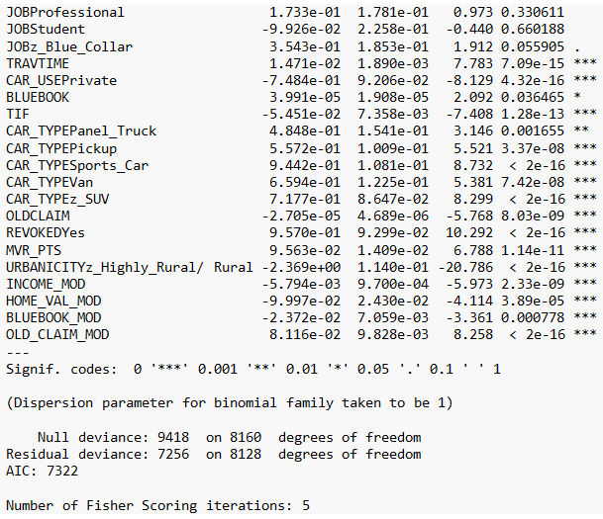

Slide 22
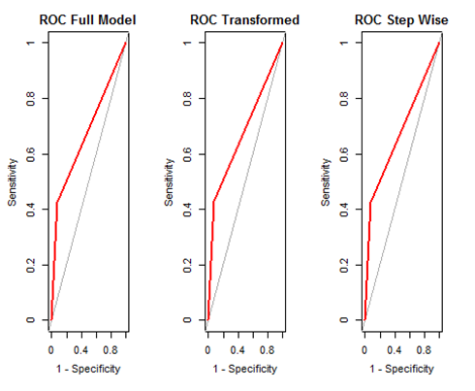
ROC Curves

Slide 23
Model Selection Base
 | Full Model | Transformed | Step Wise
Sensitivity | 0.8180077 | 0.8180879 | 0.8174591
Specificity | 0.6676364 | 0.6652205 | 0.6673977
Pos Pred Value | 0.9239348 | 0.9229361 | 0.9242676
Neg Pred Value | 0.4263818 | 0.4273107 | 0.4240595
Precision | 0.9239348 | 0.9229361 | 0.9242676
Recall | 0.8180077 | 0.8180879 | 0.8174591
F1 | 0.8677505 | 0.8673549 | 0.8675885
Prevalence | 0.8315157 | 0.8305355 | 0.8323735
Detection Rate | 0.6801863 | 0.6794510 | 0.6804313
Det. Prevalence | 0.7361843 | 0.7361843 | 0.7361843
Bal. Accuracy | 0.7428220 | 0.7416542 | 0.7424284
AIC | 7373.591 | 7335.034 | 7321.984
AUC | 0.6751583 | 0.6751234 | 0.6741635

Slide 24
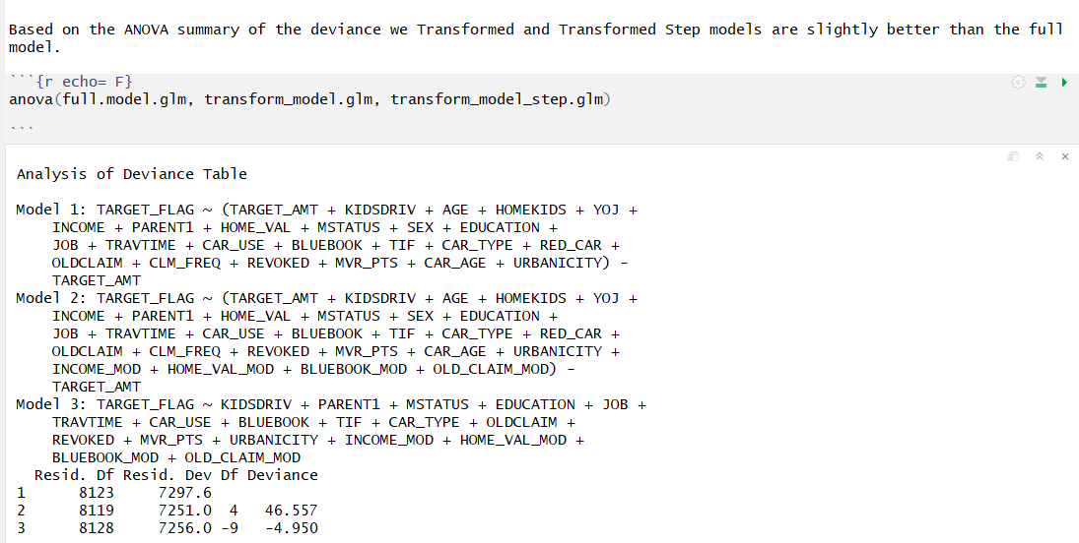
ANOVA Analysis of Three Models

Slide 25
Conclusion
All three models have very simliar AIC. Transformed and Transformed Step models have slightly better AIC values.
We will choose the transform_model_step.glm model for predicting ‘TARGET_FLAG’ because of its simplicity, fewer predictors, and slightly better AIC/Deviance over the other two models.

Slide 26
Models for TARGET_AMT
Based on the table below we see that all models with ‘TARGET_FLAG’ have higher Adjusted R-squared values. Models without TARGET_FLAG and excluding TARGET_FLAG1=0 observation have low Adjusted R-squared values, therefore doesnt explain the variablity in the data well. RMSE values for the models with TARGET_FLAGarefar better than the models without TARGET_FLAG, suggesting models with TARGET_FLAG1 are better fits the data. We believe FullOnlyFlag1Step is a better model for predicting TARGET_AMOUNT. We choose this model based on its simplcity and by examing the predicted target amount on the train data. However, we are concerned about this model’s low Adjusted R-squared value.

Slide 27
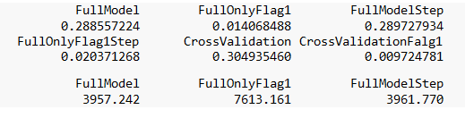

Models for TARGET_AMT

Slide 28
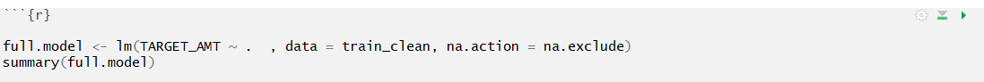
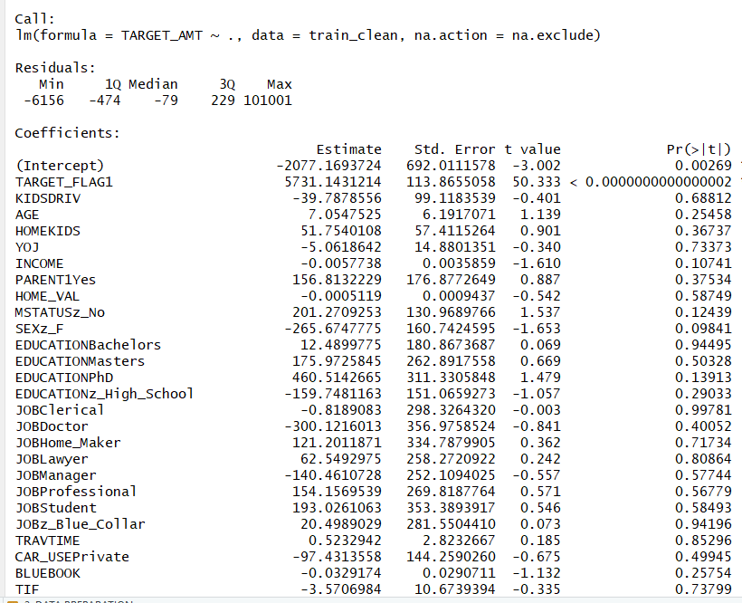
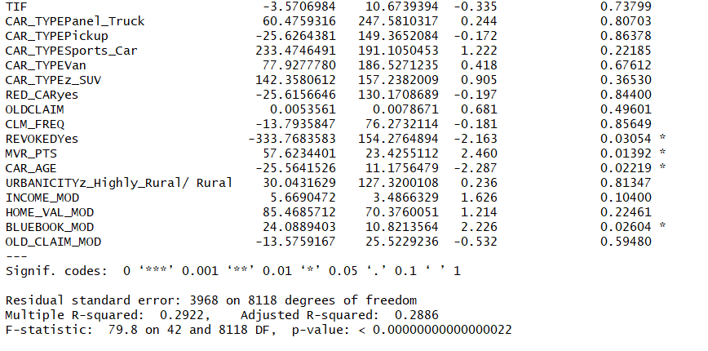
TARGET_AMT Full Model

Slide 29
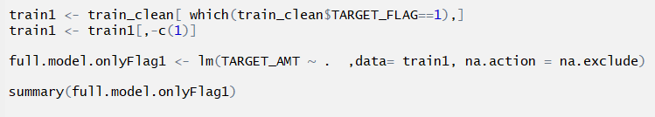
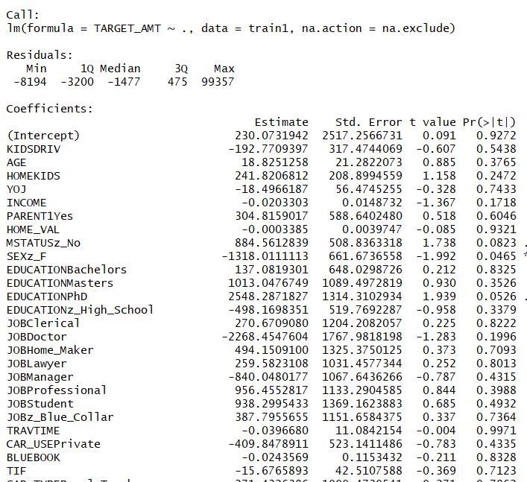
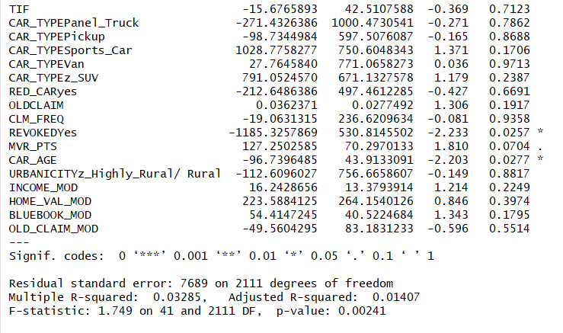
Full Model, TARGET_FLAG=1

Slide 30
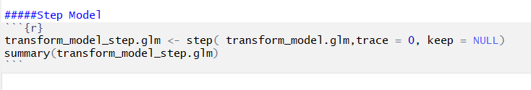
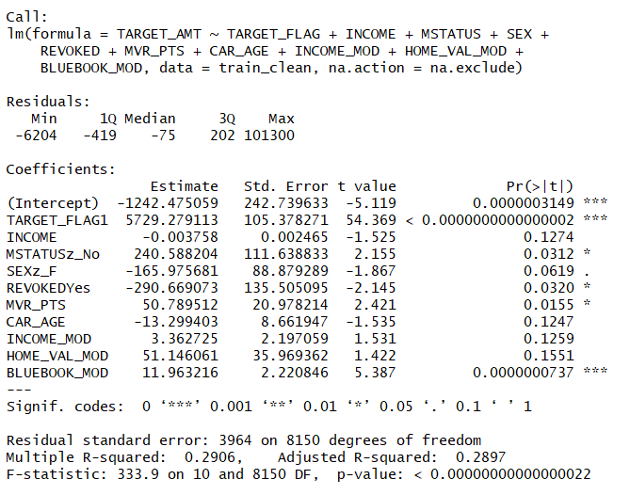
Stepwise Model

Slide 31
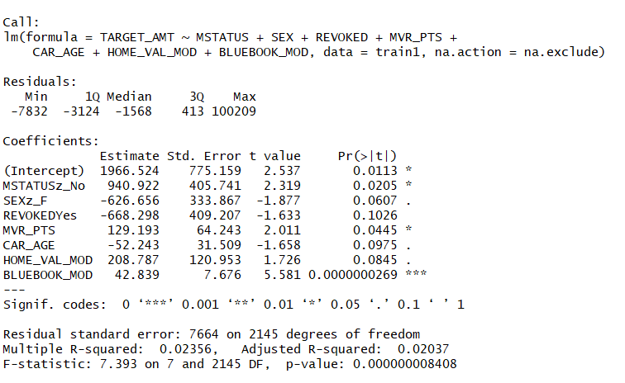
Stepwise Model: TARGET_FLAG=1

Slide 32
Summarize Statistical Significance in Different Models
Signif. codes: 0 ‘***’ 0.001 ‘**’ 0.01 ‘*’ 0.05
Signif. codes: 0 ‘***’ 0.001 ‘**’ 0.01 ‘*’ 0.05
Full model | Full Flag1 | Stepwise | Step Flag1
TARGET_FLAG1*** | SEXz_F* | TARGET_FLAG1*** | MSTATUSz_No*
KIDSDRIV** | REVOKEDYes* | MSTATUSz_No* | MVR_PTS *
REVOKEDYes* | CAR_AGE* | REVOKEDYes * | BLUEBOOK_MOD***
MVR_PTS* |  | MVR_PTS*
CAR_AGE*
BLUEBOOK_MOD*

Slide 33
 | Full model | Full Flag1 | Stepwise | Step Flag1
Residual sd error | 3968 | 7689 | 3964 | 7664
degrees of freedom | 8118 | 2111 | 8150 | 2145
Multiple R-squared | 0.2922 | 0.03285 | 0.2906 | 0.02356
Adjusted R-squared | 0.2886 | 0.01407 | 0.2897 | 0.02037
F-statistic | 79.8 | 1.749 | 333.9 | 7.393
p-value | 2.2E-16 | 0.00241 | 2.2E-16 | 8.408E-09
Residuals:
Min | -6156 | -8194 | -6204 | -7832
1Q | -474 | -3200 | -419 | -3124
Median | -79 | -1477 | -75 | -1568
3Q | 229 | 475 | 202 | 413
Max | 101001 | 99357 | 101300 | 100209
Intercept | -2077.169372 | 230.0731942 | -1242.475059 | 1966.524
Std. Error | 692.0111578 | 2517.256673 | 242.739633 | 775.159
t value | -3.002 | 0.091 | -5.119 | 2.537
Pr(>|t|) | 0.00269 | 0.9272 | 3.149E-07 | 0.0113

Slide 34
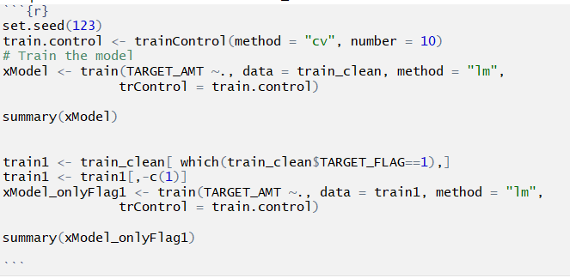
Cross Validation for Full-Model, Full-Model, FLAG = 1

Slide 35
Summary of Cross Validation
X Model | X Model Flag1
TARGET_FLAG1*** | REVOKEDYes*
REVOKEDYes* | CAR_AGE*
MVR_PTS*
CAR_AGE*
BLUEBOOK_MOD*

Slide 36
 | X Model | X Model Flag1
Residual standard error | 3968 | 7692
degrees of freedom | 8116 | 2109
Multiple R-squared | 0.2923 | 0.03299
Adjusted R-squared | 0.2884 | 0.01328
F-statistic | 76.18 | 1.673
p-value | 2.2E-16 | 0.004145
Residuals:
Min | -6492 | -8846
1Q | -471 | -3194
Median | -78 | -1492
3Q | 229 | 472
Max | 101047 | 99351
Intercept | -2029.364202 | 253.505716
Std. Error | 697.6220084 | 2544.530909
t value | -2.909 | 0.1
Pr(>|t|) | 0.00364 | 0.9206

Slide 37
Model for Predict Target_AMT
Based on the table below we see that all models with ‘TARGET_FLAG’ have higher Adjusted R-squared values. Models without TARGET_FLAG and excluding TARGET_FLAG1=0 observation have low Adjusted R-squared values, therefore doesnt explain the variablity in the data well. RMSE values for the models with TARGET_FLAGarefar better than the models without TARGET_FLAG, suggesting models with TARGET_FLAG1 are better fits the data. We believe FullOnlyFlag1Step is a better model for predicting TARGET_AMOUNT. We choose this model based on its simplcity and by examing the predicted target amount on the train data. However, we are concerned about this model’s low Adjusted R-squared value.

Slide 38
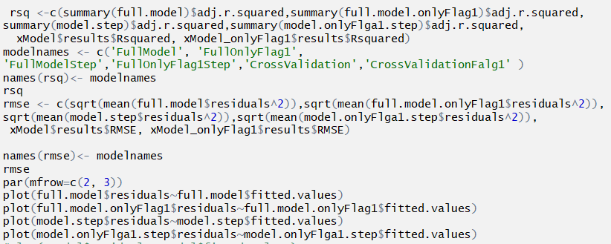

Slide 39
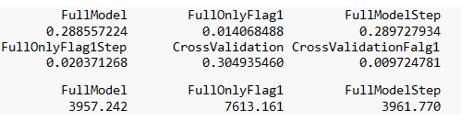


Slide 40
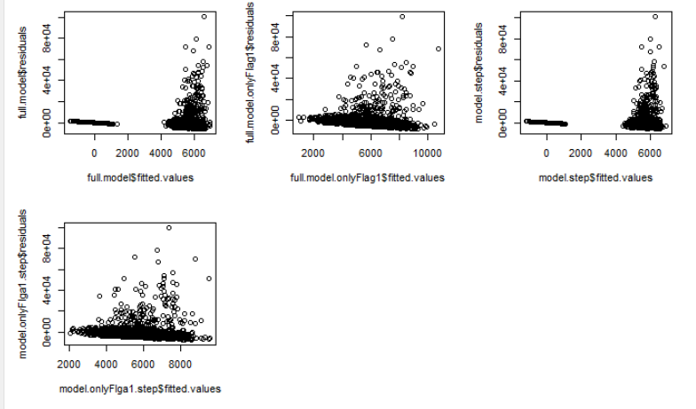

Slide 41
For the comparation of all models. We feel that the models with all rows are better than with the rows only if TARGET_FLAG == 1.
The full model and Stepwise model are very similar. Stepwise model may be better than the full model.

Slide 42
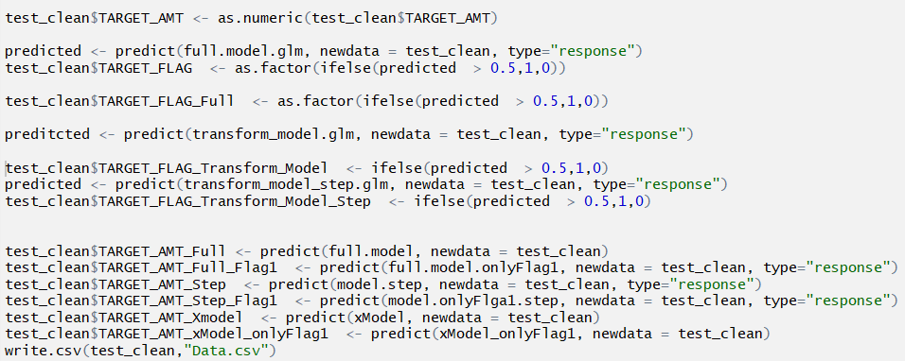
Test Models on Evaluation Data

